Slide 1

From Moonshot to Mars
Remy Bien
Ruben Bras
Sebastiaan Groot
Marvin Hiemstra
Wouter Miltenburg
Koen Veelenturf
1
Notes:
6/10/13

Slide 2

Table of content
Moonshot
Assignment
Preliminary research
JaNET’s Moonshot
FreeRADIUS Module
Notes:
6/10/13

Slide 3
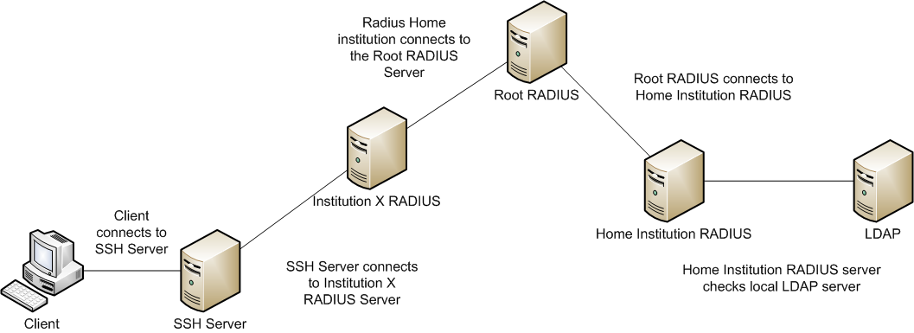
Moonshot
What is Moonshot?
How it should work
Notes:
6/10/13

Slide 4
Assignment
Goal
Scope
Notes:
6/10/13

Slide 5
Preliminary Research
GSS-API
Kerberos
RADIUS
EAP-TTLS
SSH
SAML
SurfConext / VOMS
Access Point Software
Eduroam
Spacenet
OpenSocial
JaNET

Slide 6
Preliminary Research
GSS-API
Kerberos
RADIUS
EAP-TTLS
SSH
SAML
SurfConext / VOMS
Access Point Software
Eduroam
Spacenet
OpenSocial
JaNET

Slide 7
OpenSSH Server 5.9p1
Moonshooting the server
Trying to understand internal authentication
Code analysis
Debugging
Existing solutions not secure and inflexible
JaNET already developing a solution

Slide 8


JaNET’s Moonshot
Organisation
Implementation
Progress
Known issues
Notes:
6/10/13

Slide 9
JaNET’s Moonshot: Organisation
ISP and research institution
Moonshot development
Clients
Educational institutions
Research institutions
Notes:
6/10/13

Slide 10
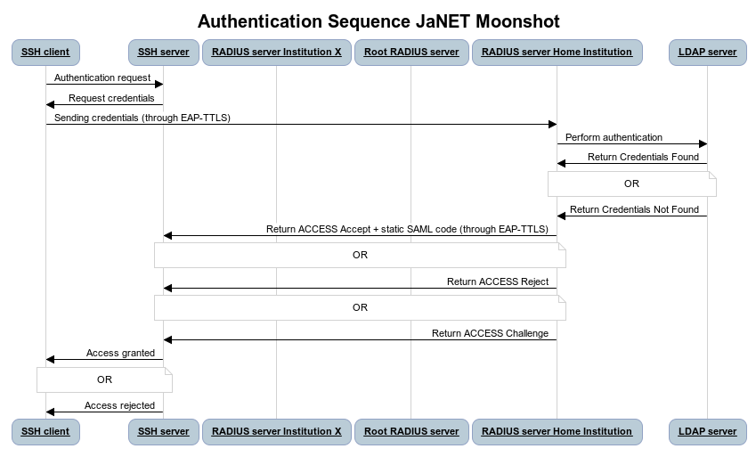
JaNET’s Moonshot: Implementation
Notes:
6/10/13

Slide 11
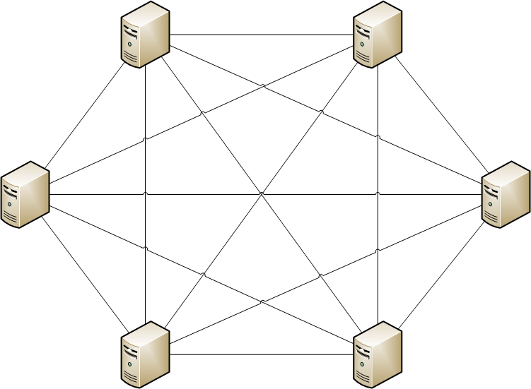
JaNET’s Moonshot: Implementation
Trust Router
Notes:
6/10/13

Slide 12
JaNET’s Moonshot: Progress
Pilot
OpenSSH
Moonshot UI
Moonshot authentication
Trust-router Beta
Debian “Wheezy” only – CentOS in development
Notes:
6/10/13

Slide 13
JaNET’s Moonshot: Known Issues
CentOS packages
Moonshot-UI problems
“steve@local”
Certificate Validation
.gss_id file
Documentation
Compiling code CentOS
OpenSSH client problems
Work in progress (JaNET)
Compile issues Ubuntu
Reported to JaNET
Notes:
6/10/13

Slide 14

FreeRADIUS Module
Introduction
Protocol specification
Proof of Concept
Future work
Notes:
6/10/13

Slide 15
FreeRADIUS Module: Introduction
Using regular RADIUS traffic
Third-party attribute providers
Easily implemented as modules on existing infrastructures
Notes:
6/10/13

Slide 16
FreeRADIUS Module: Protocol Specification
Three actors
Client
Proxy-RADIUS server
IDP-RADIUS server
Five states
Client: Sending Access-Request
Proxy: Proxying Access-Request
IDP: Evaluating the Access-Request
Proxy: Proxying the repose
Client: Evaluating the respons
Notes:
6/10/13

Slide 17
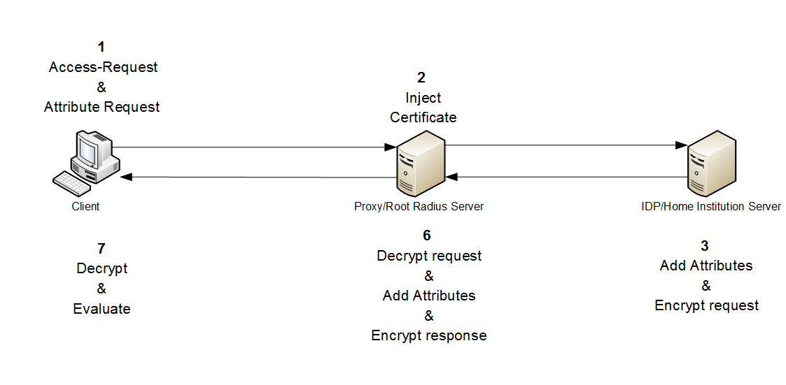

Slide 18
FreeRADIUS Module: Protocol Specification
URN formats:
Client request
Timestamp:Service DN:Proxy DN:Required Attibutes:Requested Attributes
IDP Response
Timestamp:Service DN:IDP DN:Provided AVPs:Requested Attributes
Proxy response
Timestamp:Proxy DN:Requested AVPs
Notes:
6/10/13

Slide 19
12345:DC=HVA,DC=NL,CN=SSHD:DC=SURFNET,DC=NL,CN=SurfConext:2: UserName:SurfConextPassword:1:SurfConextGroup
12352:DC=HVA,DC=NL,CN=SSHD:DC=NIKHEF,DC=NL,CN=RADIUSD:2:UserName=sgroot:SuftConextPassword=testing123:1:SurfConextGroup
12380:DC=SURFNET,DC=NL,CN=SurfConext:1:SurfConextGroup=HvAStudent
Notes:
6/10/13

Slide 20
12345:DC=HVA,DC=NL,CN=SSHD:DC=SURFNET,DC=NL,CN=SurfConext:2: UserName:SurfConextPassword:1:SurfConextGroup
12352:DC=HVA,DC=NL,CN=SSHD:DC=NIKHEF,DC=NL,CN=RADIUSD:2:UserName=sgroot:SuftConextPassword=testing123:1:SurfConextGroup
12380:DC=SURFNET,DC=NL,CN=SurfConext:1:SurfConextGroup=HvAStudent
Notes:
6/10/13

Slide 21
12345:DC=HVA,DC=NL,CN=SSHD:DC=SURFNET,DC=NL,CN=SurfConext:2: UserName:SurfConextPassword:1:SurfConextGroup
12352:DC=HVA,DC=NL,CN=SSHD:DC=NIKHEF,DC=NL,CN=RADIUSD:2:UserName=sgroot:SuftConextPassword=testing123:1:SurfConextGroup
12380:DC=SURFNET,DC=NL,CN=SurfConext:1:SurfConextGroup=HvAStudent
Notes:
6/10/13

Slide 22
12345:DC=HVA,DC=NL,CN=SSHD:DC=SURFNET,DC=NL,CN=SurfConext:2: UserName:SurfConextPassword:1:SurfConextGroup
12352:DC=HVA,DC=NL,CN=SSHD:DC=NIKHEF,DC=NL,CN=RADIUSD:2:UserName=sgroot:SuftConextPassword=testing123:1:SurfConextGroup
12380:DC=SURFNET,DC=NL,CN=SurfConext:1:SurfConextGroup=HvAStudent
Notes:
6/10/13

Slide 23
12345:DC=HVA,DC=NL,CN=SSHD:DC=SURFNET,DC=NL,CN=SurfConext:2: UserName:SurfConextPassword:1:SurfConextGroup
12352:DC=HVA,DC=NL,CN=SSHD:DC=NIKHEF,DC=NL,CN=RADIUSD:2:UserName=sgroot:SuftConextPassword=testing123:1:SurfConextGroup
12380:DC=SURFNET,DC=NL,CN=SurfConext:1:SurfConextGroup=HvAStudent
Notes:
6/10/13

Slide 24
12345:DC=HVA,DC=NL,CN=SSHD:DC=SURFNET,DC=NL,CN=SurfConext:2: UserName:SurfConextPassword:1:SurfConextGroup
12352:DC=HVA,DC=NL,CN=SSHD:DC=NIKHEF,DC=NL,CN=RADIUSD:2:UserName=sgroot:SuftConextPassword=testing123:1:SurfConextGroup
12380:DC=SURFNET,DC=NL,CN=SurfConext:1:SurfConextGroup=HvAStudent
Notes:
6/10/13

Slide 25
12345:DC=HVA,DC=NL,CN=SSHD:DC=SURFNET,DC=NL,CN=SurfConext:2: UserName:SurfConextPassword:1:SurfConextGroup
12352:DC=HVA,DC=NL,CN=SSHD:DC=NIKHEF,DC=NL,CN=RADIUSD:2:UserName=sgroot:SuftConextPassword=testing123:1:SurfConextGroup
12380:DC=SURFNET,DC=NL,CN=SurfConext:1:SurfConextGroup=HvAStudent
Notes:
6/10/13

Slide 26
12345:DC=HVA,DC=NL,CN=SSHD:DC=SURFNET,DC=NL,CN=SurfConext:2: UserName:SurfConextPassword:1:SurfConextGroup
12352:DC=HVA,DC=NL,CN=SSHD:DC=NIKHEF,DC=NL,CN=RADIUSD:2:UserName=sgroot:SuftConextPassword=testing123:1:SurfConextGroup
12380:DC=SURFNET,DC=NL,CN=SurfConext:1:SurfConextGroup=HvAStudent
Notes:
6/10/13

Slide 27
12345:DC=HVA,DC=NL,CN=SSHD:DC=SURFNET,DC=NL,CN=SurfConext:2: UserName:SurfConextPassword:1:SurfConextGroup
12352:DC=HVA,DC=NL,CN=SSHD:DC=NIKHEF,DC=NL,CN=RADIUSD:2:UserName=sgroot:SuftConextPassword=testing123:1:SurfConextGroup
12380:DC=SURFNET,DC=NL,CN=SurfConext:1:SurfConextGroup=HvAStudent
Notes:
6/10/13

Slide 28
12345:DC=HVA,DC=NL,CN=SSHD:DC=SURFNET,DC=NL,CN=SurfConext:2: UserName:SurfConextPassword:1:SurfConextGroup
12352:DC=HVA,DC=NL,CN=SSHD:DC=NIKHEF,DC=NL,CN=RADIUSD:2:UserName=sgroot:SuftConextPassword=testing123:1:SurfConextGroup
12380:DC=SURFNET,DC=NL,CN=SurfConext:1:SurfConextGroup=HvAStudent
Notes:
6/10/13

Slide 29
12345:DC=HVA,DC=NL,CN=SSHD:DC=SURFNET,DC=NL,CN=SurfConext:2: UserName:SurfConextPassword:1:SurfConextGroup
12352:DC=HVA,DC=NL,CN=SSHD:DC=NIKHEF,DC=NL,CN=RADIUSD:2:UserName=sgroot:SuftConextPassword=testing123:1:SurfConextGroup
12380:DC=SURFNET,DC=NL,CN=SurfConext:1:SurfConextGroup=HvAStudent
Notes:
6/10/13

Slide 30
12345:DC=HVA,DC=NL,CN=SSHD:DC=SURFNET,DC=NL,CN=SurfConext:2: UserName:SurfConextPassword:1:SurfConextGroup
12352:DC=HVA,DC=NL,CN=SSHD:DC=NIKHEF,DC=NL,CN=RADIUSD:2:UserName=sgroot:SuftConextPassword=testing123:1:SurfConextGroup
12380:DC=SURFNET,DC=NL,CN=SurfConext:1:SurfConextGroup=HvAStudent
Notes:
6/10/13

Slide 31
12345:DC=HVA,DC=NL,CN=SSHD:DC=SURFNET,DC=NL,CN=SurfConext:2: UserName:SurfConextPassword:1:SurfConextGroup
12352:DC=HVA,DC=NL,CN=SSHD:DC=NIKHEF,DC=NL,CN=RADIUSD:2:UserName=sgroot:SuftConextPassword=testing123:1:SurfConextGroup
12380:DC=SURFNET,DC=NL,CN=SurfConext:1:SurfConextGroup=HvAStudent
Notes:
6/10/13

Slide 32
FreeRADIUS Module: Protocol Specification
Message formats
MIME plain text
SMIME signed & encrypted plain text
SMIME certificate-only
Notes:
6/10/13

Slide 33
FreeRADIUS Module: Proof of Concept
Demonstration
Notes:
6/10/13

Slide 34
FreeRADIUS Module: Future work
Enabling SMIME decryption / validation support
Supporting multiple RADIUS proxy servers
Diffie-Hellman Key Exchange
Client implementation
User or service as client
LDAP / VOMS / SurfConext implementations
Notes:
6/10/13

Slide 35
Questions?
Notes:
6/10/13

